Slide 1
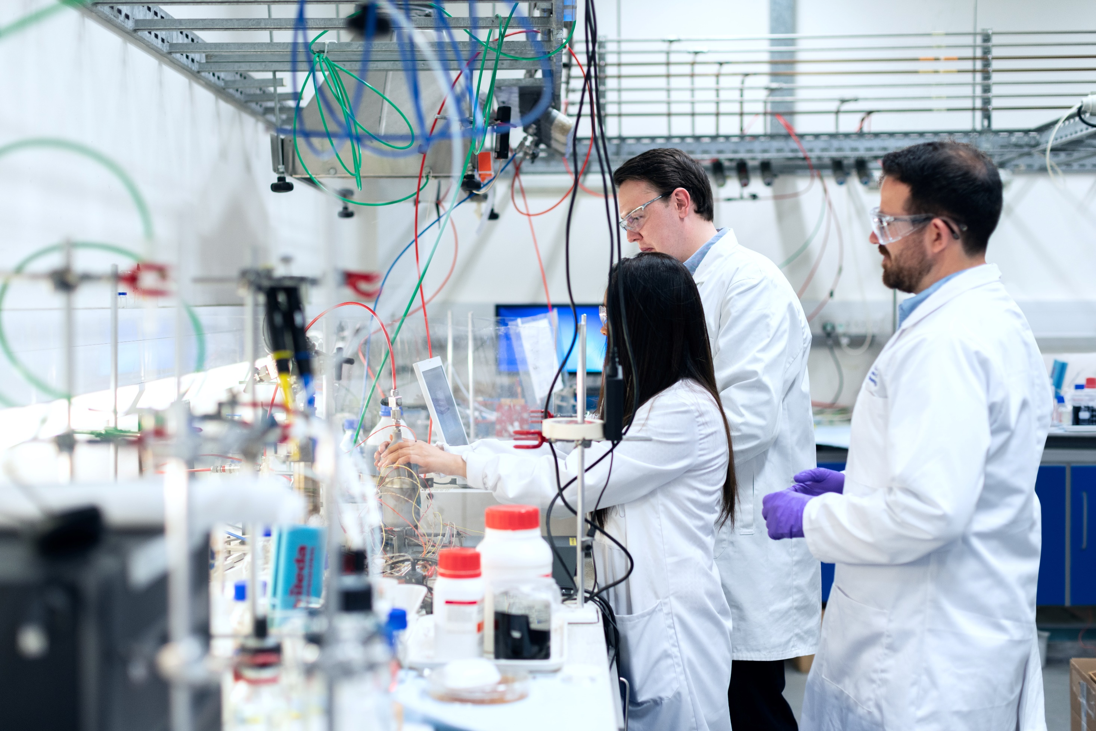







Student Material Drive
An Open-Source Departmental Study Material Platform
An Open Source Departmental Study Material Platform
The Student Material Drive
Collaborative Platform
Study Resources
Open-Source
Building a community-driven system for knowledge sharing
Centralized access to lecture notes, past exams and references
Built with modern web technologies and Supabase
Group 2 — Team Archive
Team Members:
Fattahan Taiwo Adeiza
Musa Yusuf Galambi
Muhammad Saidu Hassan
Kadijah Ibrahim
Fattahan Taiwo Adeiza
Musa Yusuf Galambi
Abubakar Sadiq Yunusa
Adam Abubakar Adam
CSE404 - Open Source Software Development
Team Members:
Muhammad Saidu Hassan
Kadijah Ibrahim
CSE404 - Open Source Software Development
Mahmud Yahaya Abubakar
Ahmad Muhammad Auwal
Computer Science Department
Abubakar Sadiq Yunusa
Adam Abubakar Adam
Software Engineering Department
Umar Salihu Faruk
Omokayode Abdulqudus Abdulrahman

Slide 2













Introduction: Problem Statement
University students face significant challenges in accessing essential study materials
Past examination papers, lecture notes, and reference resources are often difficult to obtain
Lecture Notes
Exam Papers
Current sharing methods (WhatsApp groups, word-of-mouth, flash drives) are inherently decentralized
Fragmented approach leads to inefficiencies and lost information
Assignments
References
Unequal access among students creates disparities in academic resources
Need: A centralized, reliable, and open-source solution to streamline the distribution and accessibility of academic resources

Slide 3










Project Objectives
Student Material Drive
Key Objectives for this open-source platform
Build Collaborative Platform
Use a Familar Modern Web Tech
Create an open-source platform for sharing study materials among university students
Implement with HTML, CSS, JavaScript, and Supabase for authentication and storage
Encourage Contribution
Ensure Transparency
Foster a culture of student contribution and knowledge sharing
Make educational resources accessible to all registered users
Result: A centralized system that transforms how students access and share academic resources

Slide 4











Project Design & Architecture
Frontend
Supabase
Files
Metadata
HTML, CSS, JavaScript
Authentication
Database
Storage
Authentication
Database
Storage
Secure user sign-up, login, and session management using JWT-based tokens and Role-based Access Control
PostgreSQL tracks file metadata including title, uploader, and course information for search & filtering
S3-compatible object storage for uploaded files with custom policies and permissions
This architecture ensures a clear separation of concerns and utilizes Supabase's integrated services for a streamlined development process

Slide 5











Implemented Features
User Authentication
File Upload
Secure sign-up with email and password
Support for PDFs and lecture notes
JWT-based secure sessions
Secure storage with Supabase
Role-based Access Control (RBAC)
Custom policies and permissions
Implementation
Complete
Implementation
Complete
Materials Display
Search & Filtering
Organized list of uploaded files
Keyword search functionality
Clear file structure
Filter by course
Visual organization system
Enhanced discoverability
Implementation
Complete
Implementation
Complete

Slide 6














Future Features
Our development roadmap includes several enhancements to improve the platform's utility and user experience
Role-based Access
File Categorization
Implementation of distinct roles (administrators and students) to manage permissions and content access more granularly
Advanced categorization of materials by course or academic level to improve organization and navigation
Done Already!
Enhanced UI/UX
GitHub Pages Deployment
Continuous improvement of the user interface and user experience to ensure a more intuitive, consistent, and visually appealing platform
Plans to deploy the frontend application using GitHub Pages for easy accessibility and maintenance
Development
Testing
Feedback
Launch

Slide 7

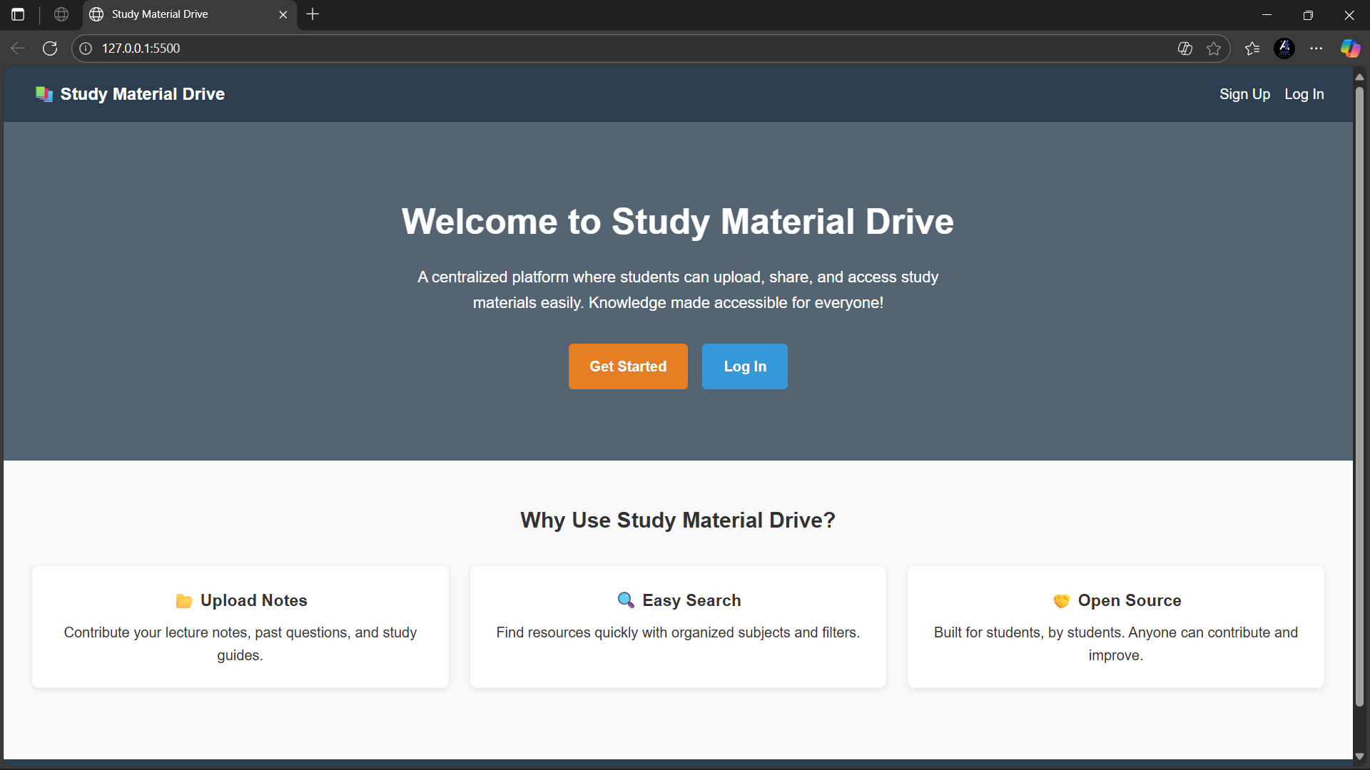
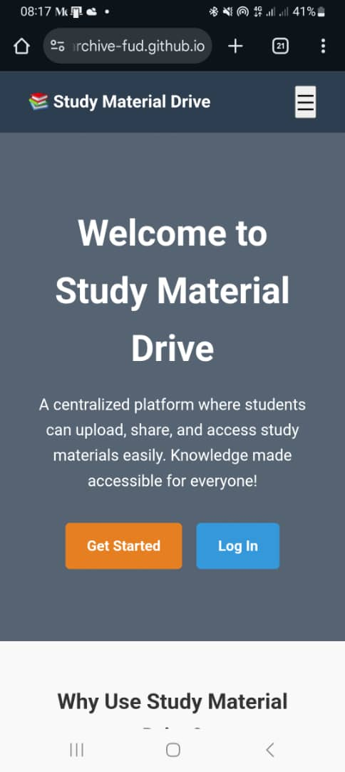
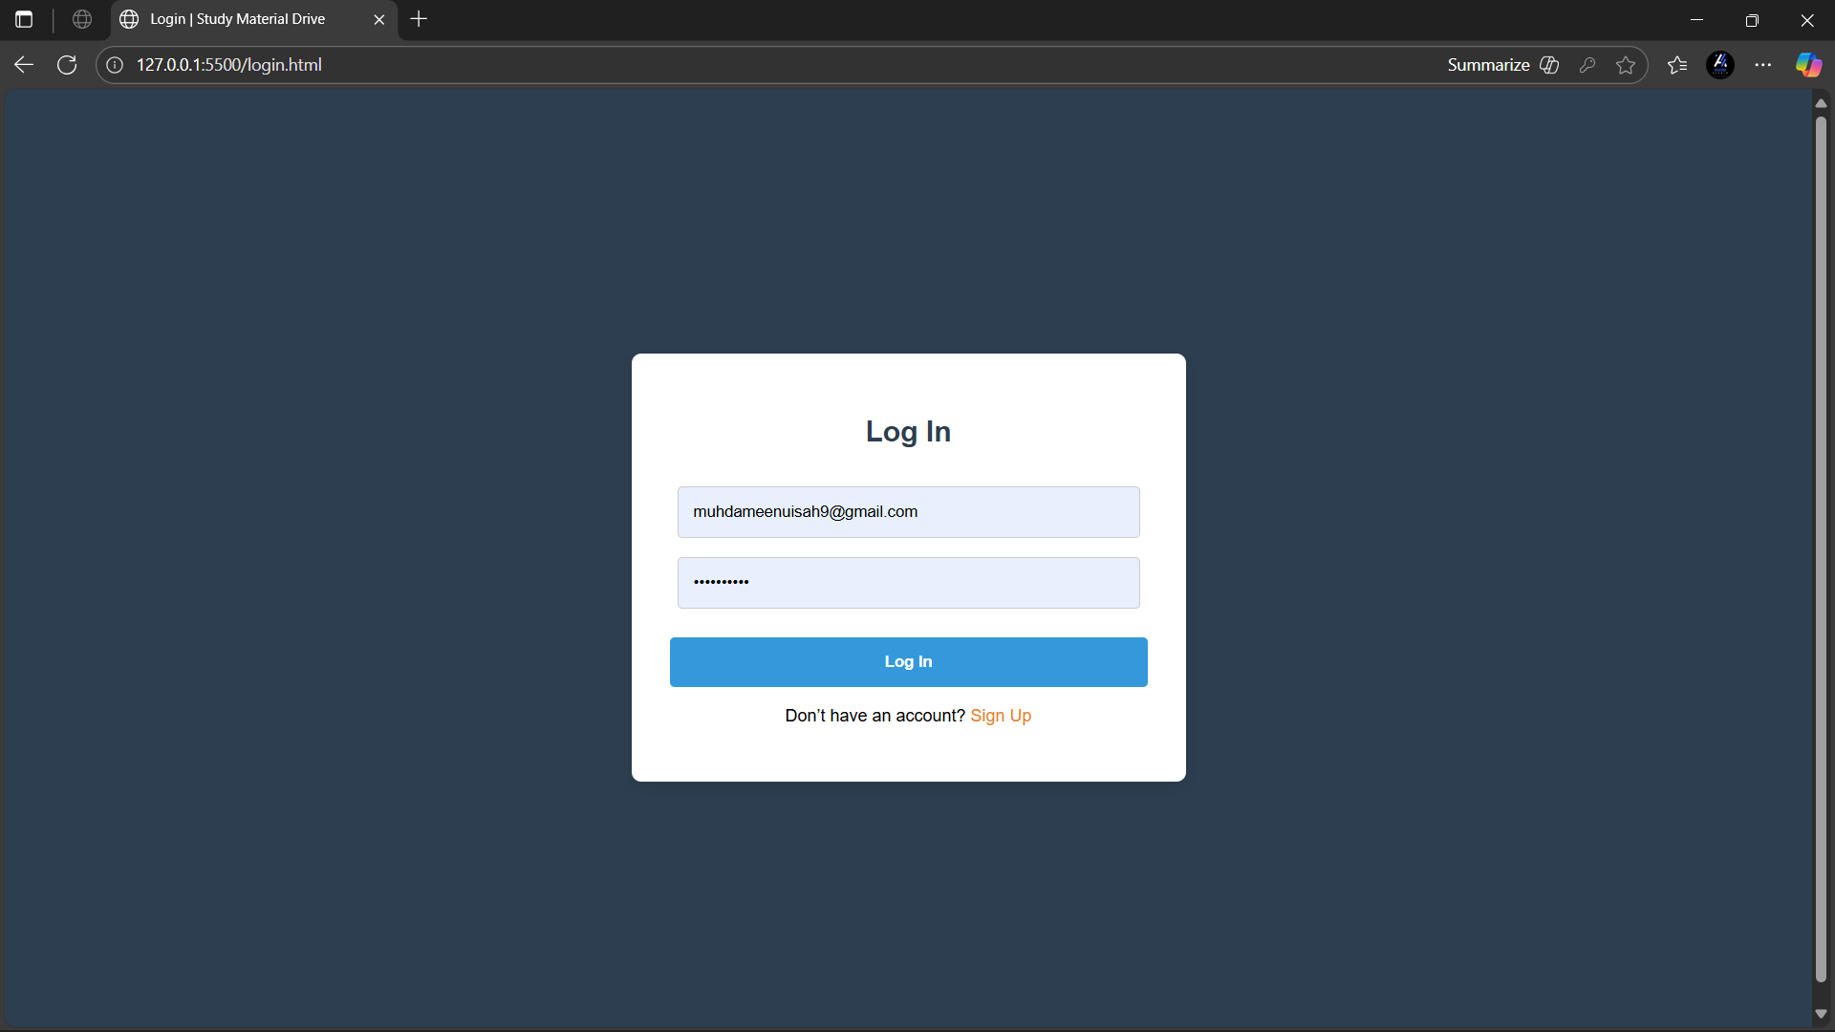
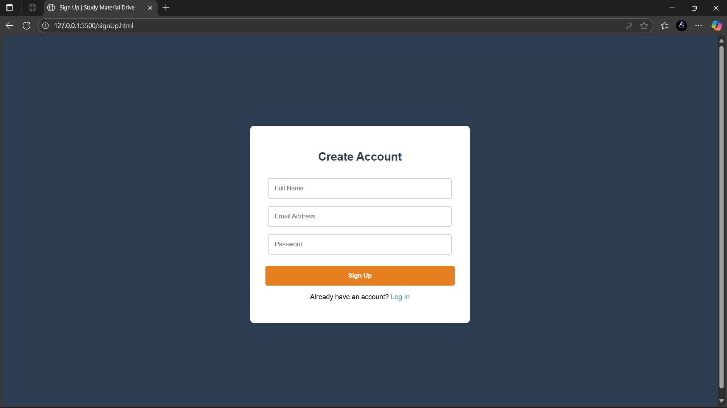


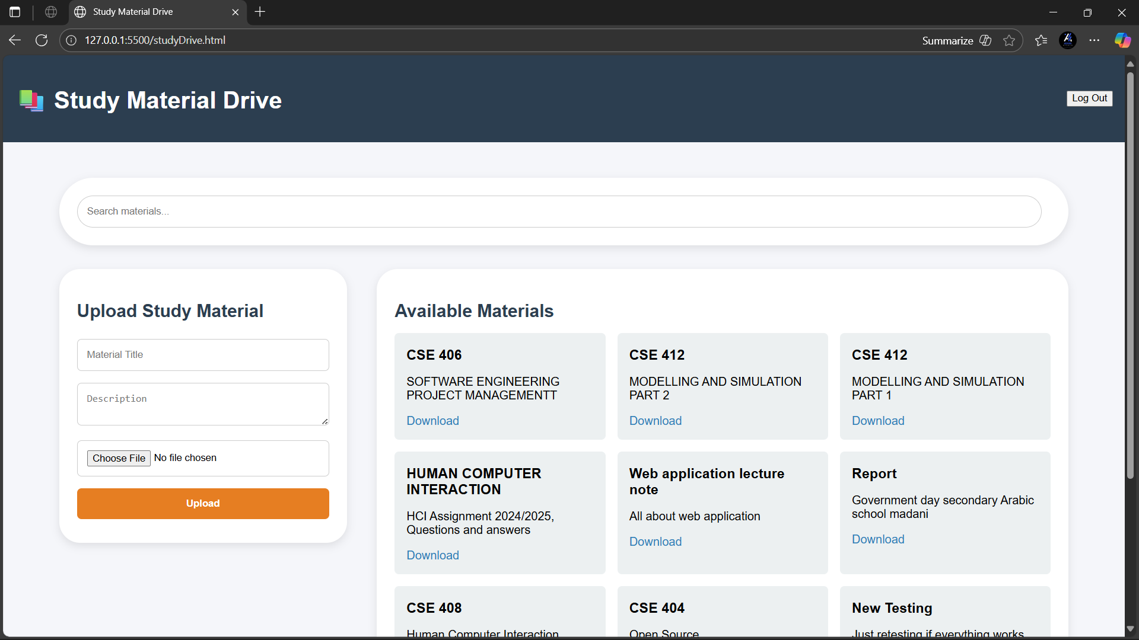
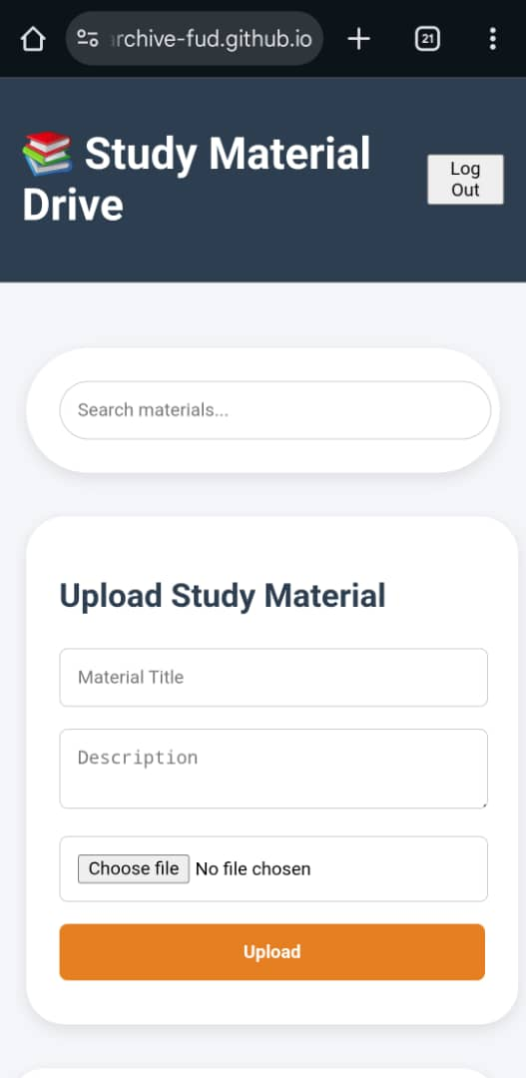
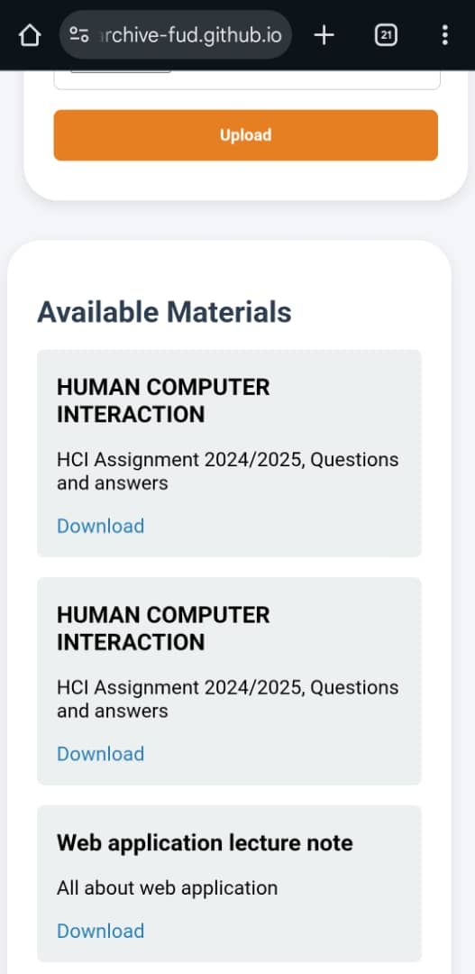
Demo Screenshots
Landing Page
Login / Sign-up Pages
The initial page users encounter, showcasing the project's branding and providing a brief overview of the platform's purpose.
Authentication interfaces for user registration and login, with fields for email, password, and options for new user registration or existing user login.
File Upload Page and
Materials Display Page
Interface where users can upload study materials, with options for file selection, title entry, and course association.
List of uploaded files with search and filter options, allowing users to browse and locate specific materials by keywords or course.
Click to view Live Site

Slide 8






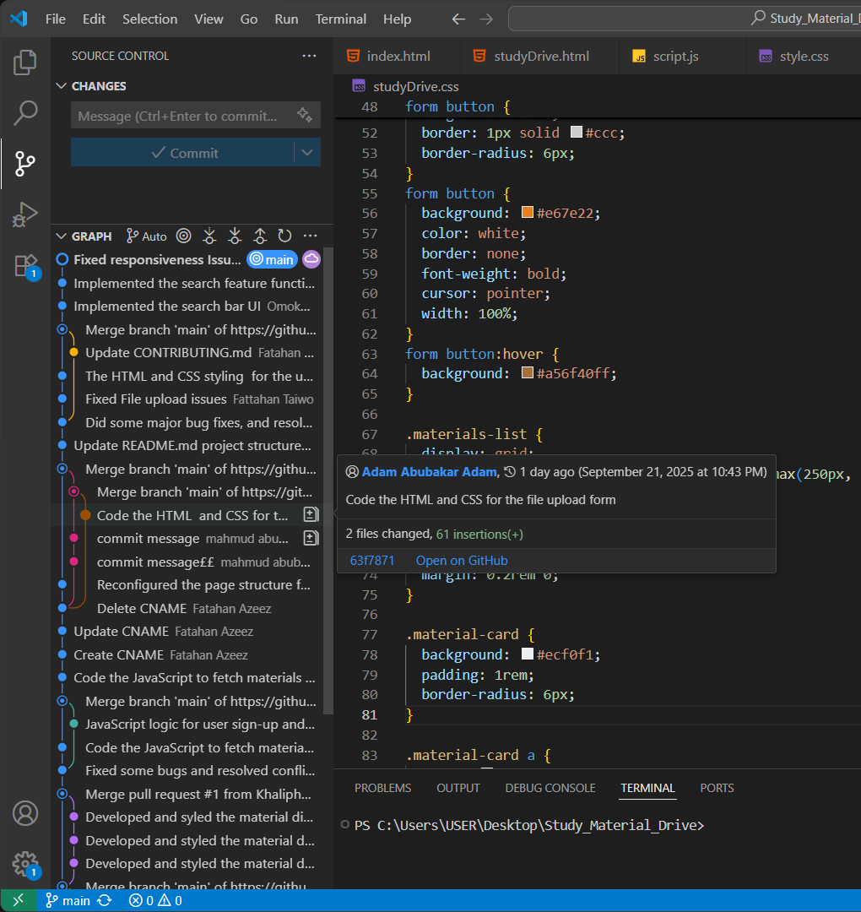
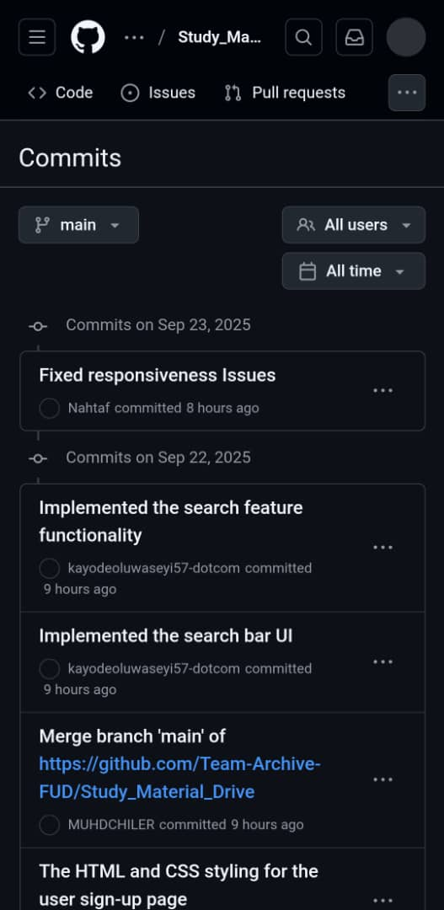
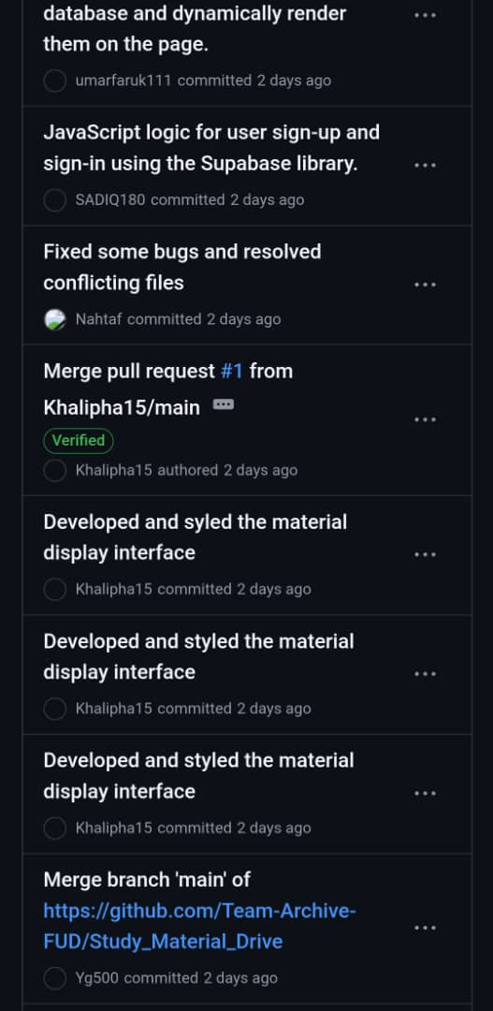






Workflow & Collaboration
GitHub Usage
Collaboration Tools
GitHub Issues & Pull Requests
Repository Setup
Used for task tracking and code reviews
Initialized with README and LICENSE files, establishing clear project structure
Supabase Project Sharing
Shared authentication, database and storage environment
Task Assignments
Tasks assigned to team members based on proposal table, ensuring clear responsibilities
Branching Strategy
Team collaboration during development
Due to limited time we couldn’t eveloped on separate branches, so we cloned the main branch, committed with descriptive messages.
Click to See github activity
Vscode git activity graph and github commit history showing our active contribution
Branch
Commit
Merge

Slide 9




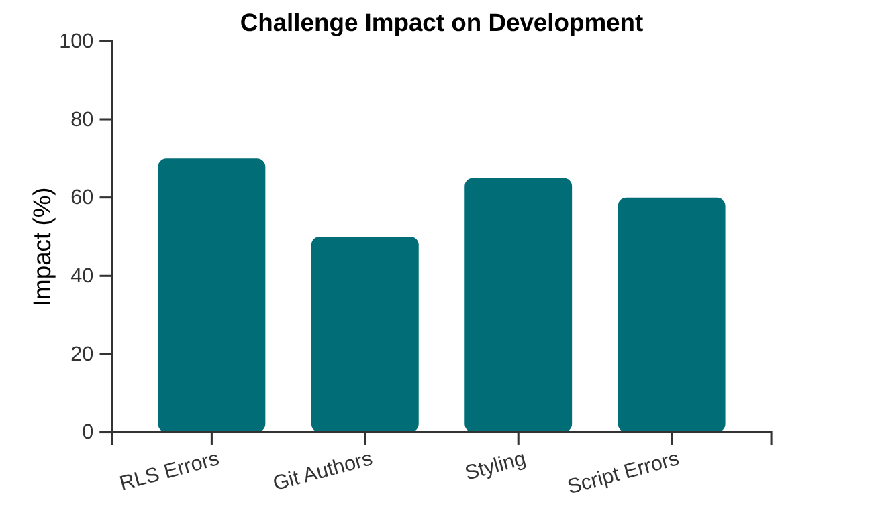







Challenges Faced
Supabase Row-Level Security (RLS) Errors
Challenge Impact
Difficulties configuring policies to allow authenticated users to upload files and access their data without unintended exposure.
GitHub Commit Issues
Most of us being the first time use github as a colloaborative tool, found it difficult at first, and it affected our project development timtlne
Styling Consistency
Maintaining visual style across multiple contributors' components, affecting overall user experience.
Key Insight
Technical challenges required significant time investment and creative solutions, but ultimately strengthened the project's design and team collaboration.
Script Path & MIME Type Errors
Incorrect script paths and MIME type errors hindered proper loading and execution of JavaScript files.

Slide 10
















Solutions Implemented
Fixed RLS with Authenticated Policies
Guide each other closely on git usage
Carefully crafted and applied authenticated policies to resolve Supabase Row-Level Security issues, ensuring users could only interact with data and files they were authorized to access.
We worked closely with each other, offering help to those who found it difficult using git, providing them with steop ny step tutorial.
Before
After
Poor Knowledge
Gained Knowledge
Introduced Common CSS Standards for UI
Wrapped Scripts with DOMContentLoaded
Established a set of common CSS standards and guidelines adopted by all contributors, unifying the visual design across the application's various interfaces.
Ensured JavaScript code executes only after the entire HTML document is loaded, preventing execution issues related to elements not yet present in the DOM.
Inconsistent
Consistent
Unstable
Stable
These solutions effectively addressed the development challenges, resulting in a more secure, reliable, and consistent Student Material Drive platform.

Slide 11


























Team Contributions
Each team member brought unique skills and responsibilities to the Student Material Drive project
Fattahan Taiwo Adeiza
Musa Yusuf Galambi
Muhammad Saidu Hassan
FCP/CSE/20/1011
FCP/CSE/20/1012
FCP/CSE/20/1013
Project Lead
GitHub Manager
UI
UI
Led the project direction, managed GitHub repository, and set up Supabase environment
Developed the landing page with a clean, professional design that sets the tone for the application
Created the sign-up page with a focus on user experience and visual appeal
Kadijah Ibrahim
Abubakar Sadiq Yunusa
Adam Abubakar Adam
FCP/CSE/20/1014
FCP/CSE/20/1016
FCP/CSE/20/1017
UI
Authentication
UI
Designed the login and logout interfaces, ensuring consistency with the overall design
Implemented authentication logic using Supabase, handling user sign-ups and logins
Developed the file upload interface, creating a clean and intuitive design
Mahmud Yahaya Abubakar
Ahmad Muhammad Auwal
Umar Salihu Faruk
Omokayode Abdulqudus Abdulrahman
FCP/CSE/20/1018
FCP/CSE/20/1019
FCP/CSE/20/1021
FCP/CSE/20/1022
Logic
UI
Logic
Logic
UI
Implemented file upload logic, handling data storage and retrieval
Created the materials display interface, focusing on usability and accessibility
Created the materials display Logic, handling data storage and retrieval
Implemented search and filtering functionality for efficient material discovery
Team members collaborated effectively, with 5 focusing on frontend UI, 4 on backend logic, and 1 on project management

Slide 12








Q & A
Key Project Achievements
Collaborative Platform
Secure Authentication
Searchable Resources
Built a system that encourages student contribution and knowledge sharing
Implemented secure user authentication with Supabase's RBAC capabilities
Created intuitive search and filtering for easy material discovery
Any Questions?
We're happy to answer questions about any aspect of the project
GitHub Repository: github.com/student-material-drive
Thank you for your attention!

